Slide 1


Teacher Training Workshop
The Biblical Foundation for BTCP
The Mandate: Mat. 28:18-20
The Means: 2 Tim. 3:16-17
The Method: Eph. 4:11-16
The Model: 2 Tim. 2:1-2

Slide 2


The Goal of This Interest Meeting
Discover BTCP’s mission, purpose, and approach
Understand how we conduct pastor training
Determine whether partnership is right for you

Slide 3

The Bible Provides the Best Model for Leadership Development

Slide 4

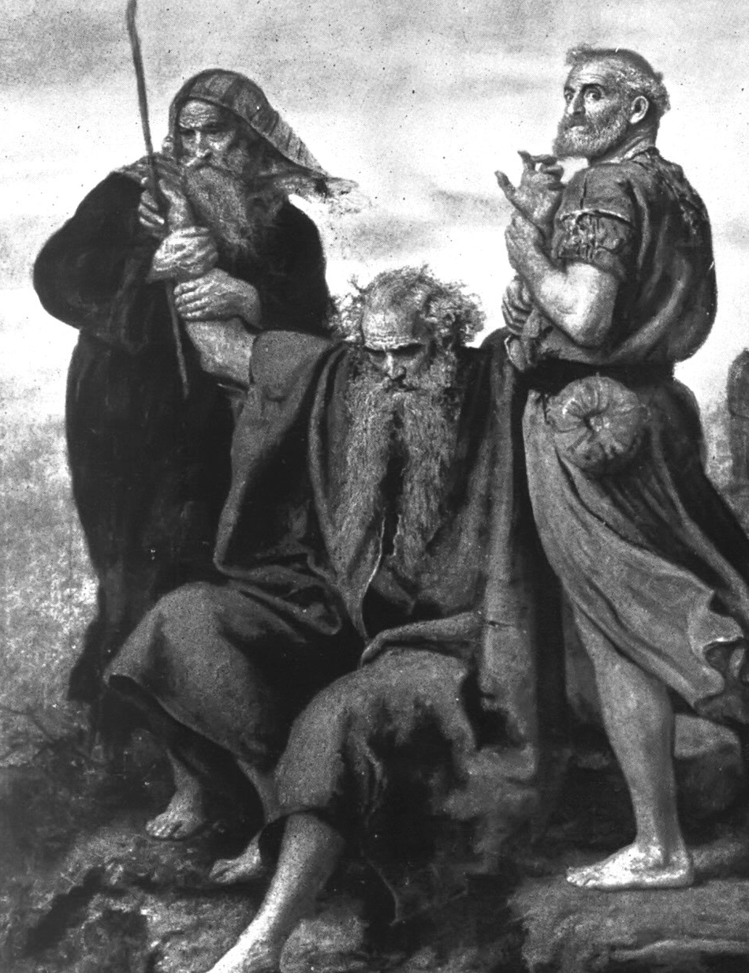
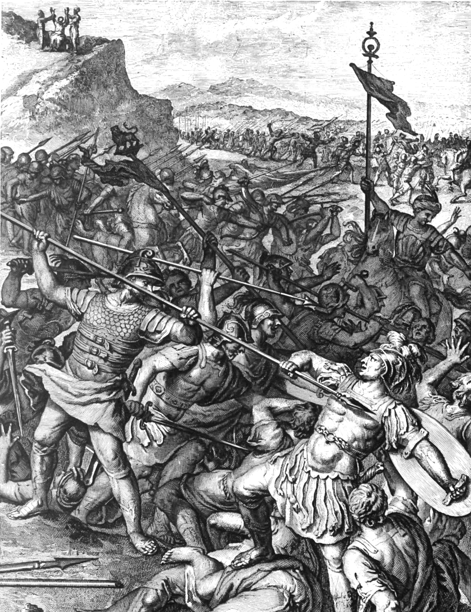
The Life-On-Life Model
Moses and Joshua

Slide 5

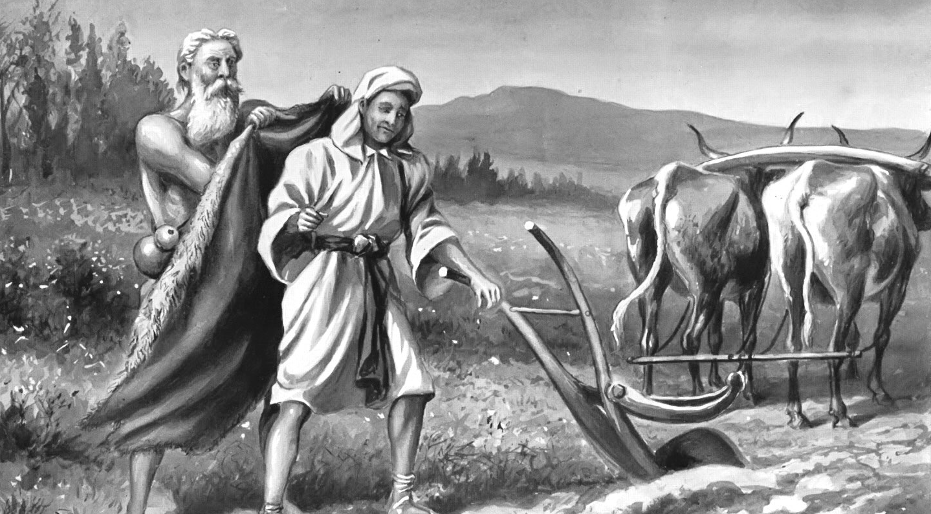
The Life-On-Life Model
Elijah and Elisha

Slide 6
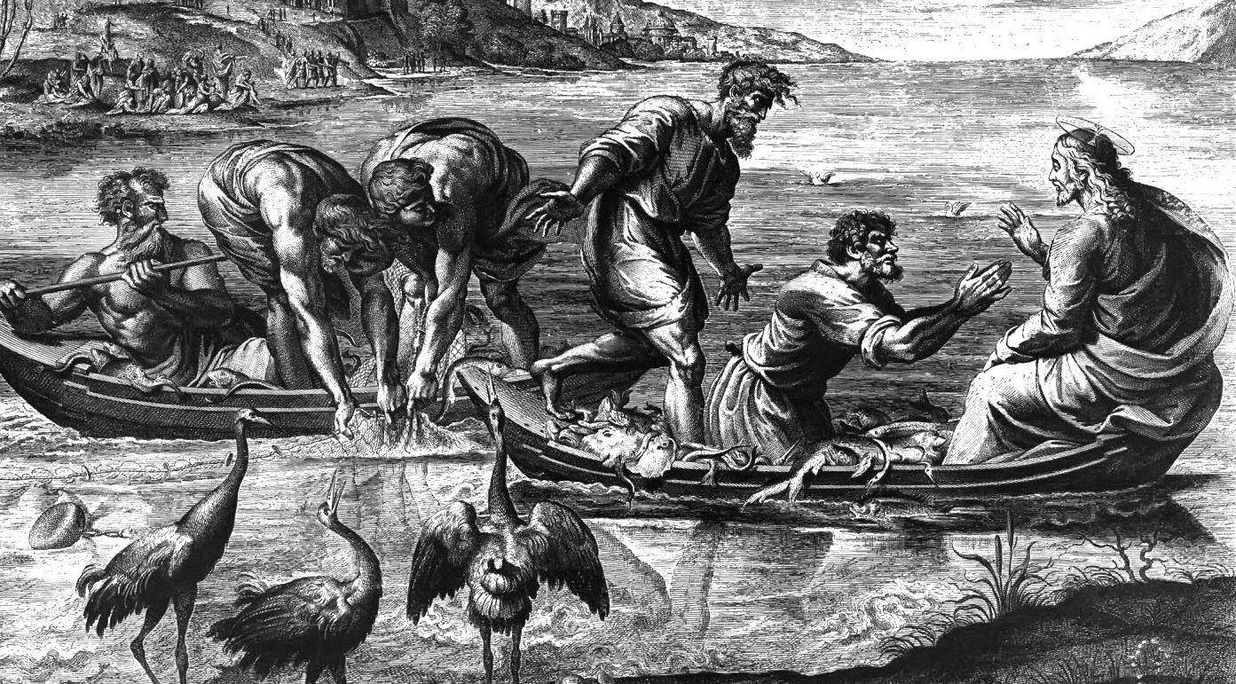
The Life-On-Life Model
Jesus and the Disciples

Slide 7

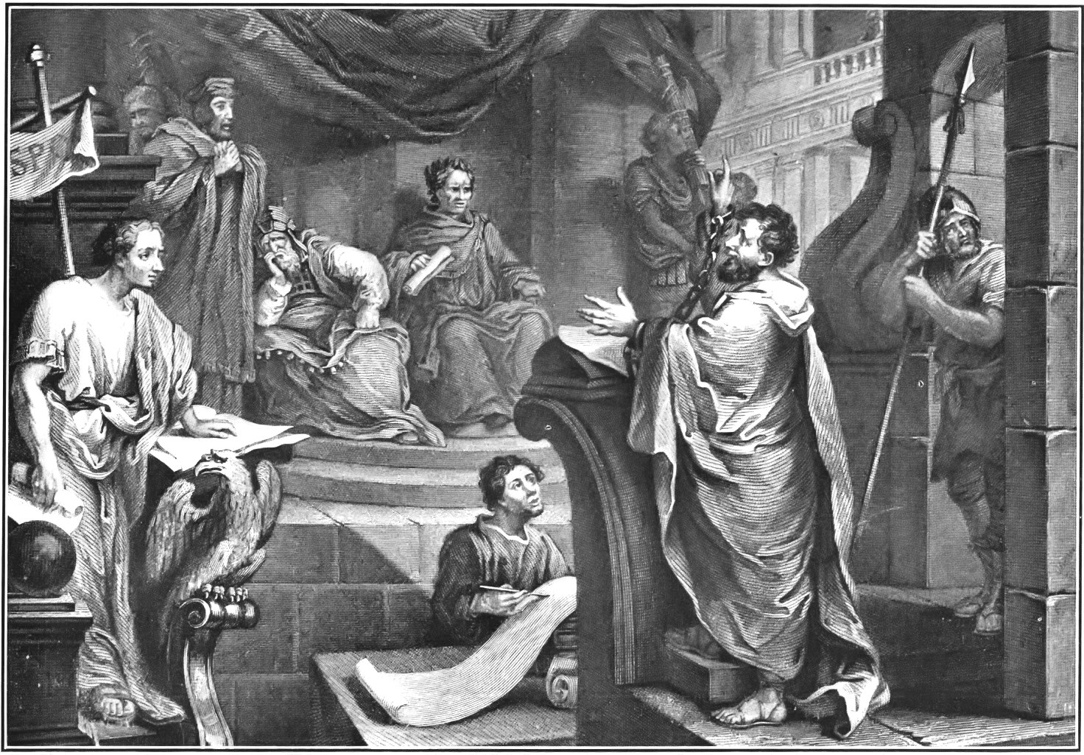
The Life-On-Life Model
Paul and Timothy

Slide 8

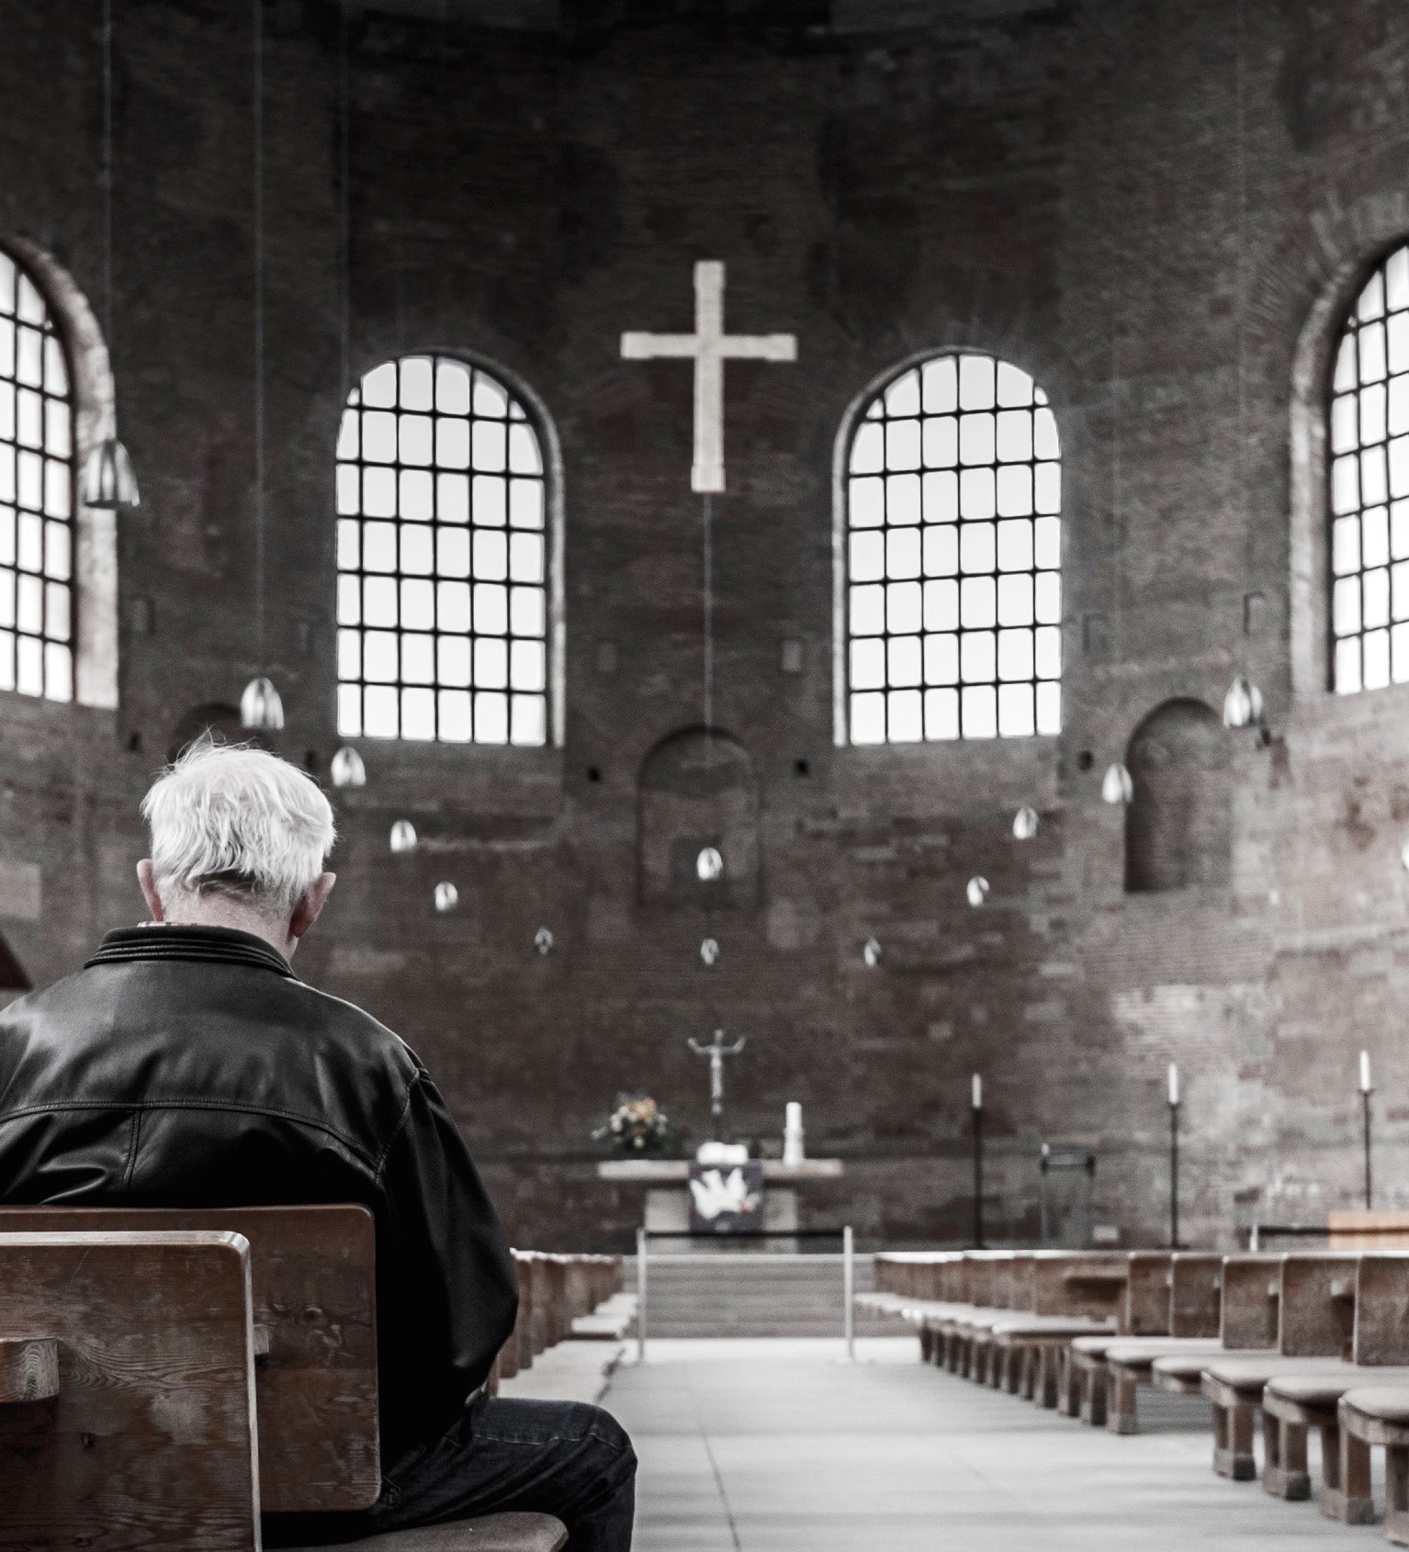
The Word of God Must be taught (Titus 2:1)
The Word of God Must be modeled (1 Cor. 4:16, 1 Cor. 11:1, 1 Thess. 1:6-7)
The Word of God Must be transferred (1 Thess. 2:6-9)

Slide 9
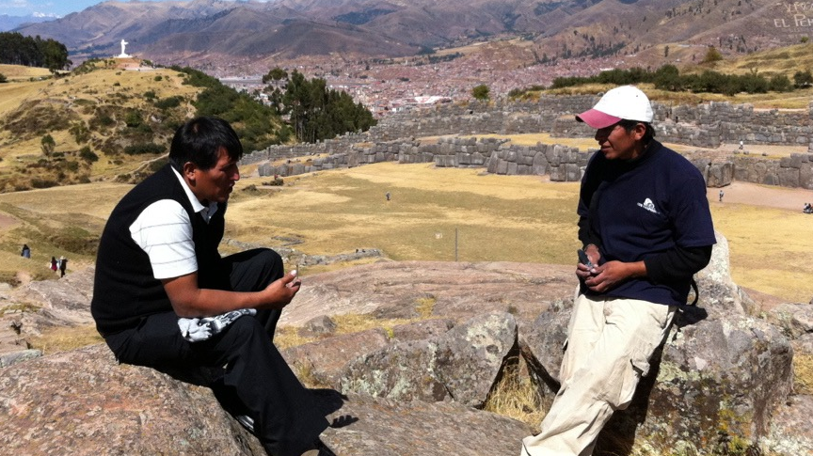
God’s model of equipping and multiplying leaders is to use His Word, taught, modeled and transferred from life-to-life.

Slide 10

Multiplication is a key objective for BTCP training.

Slide 11
3 Essential Parts of BTCP

Slide 12


3 Essential Parts of BTCP
The Bible
BTCP Manuals
Personal Teacher

Slide 13
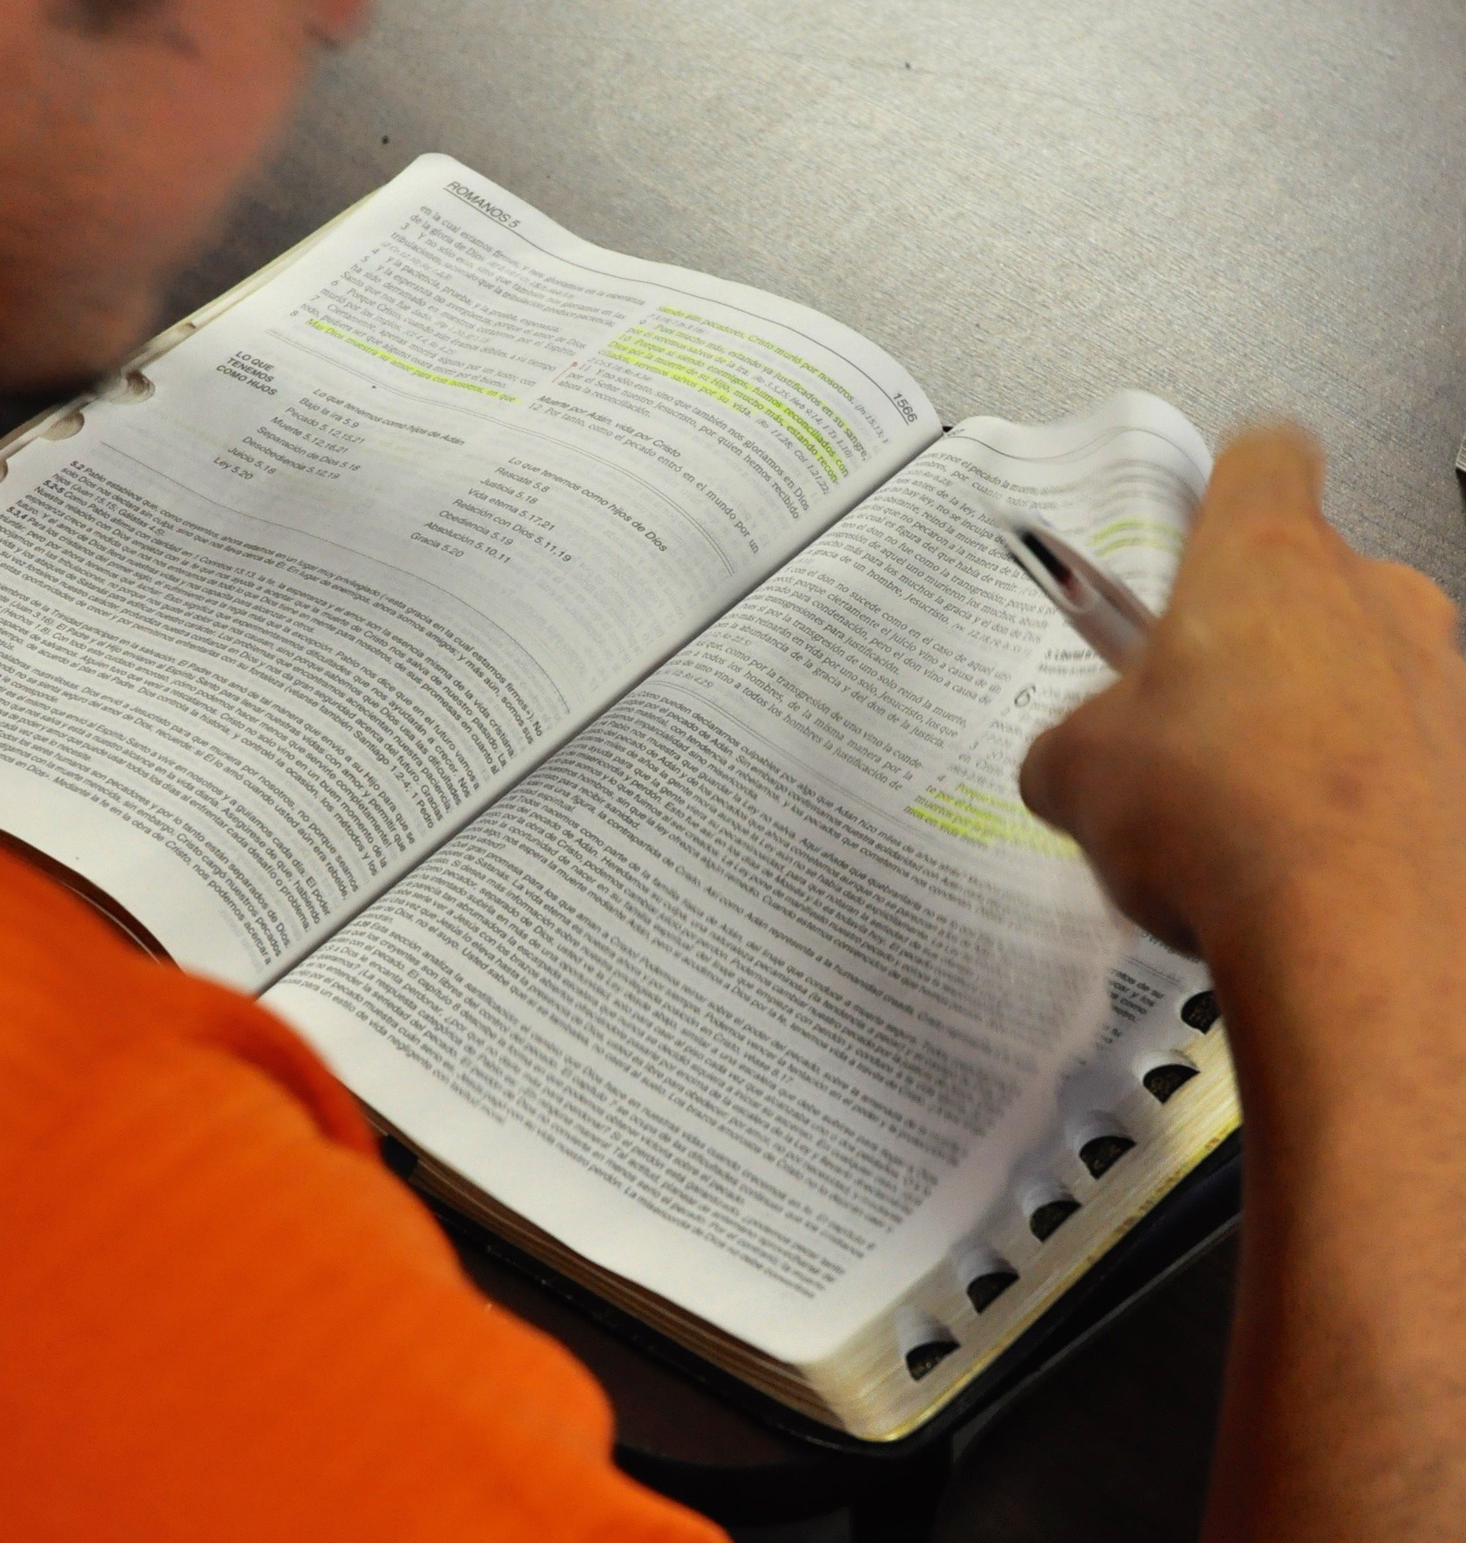
1) The Bible
The Bible is the “textbook” for every course
Students must use the same Study Bible
Students are instructed on how to use the Study Bible

Slide 14

2) BTCP Manuals
The minimum prescribed classroom hours must be met
Courses 1-6 must be taught in order
Students must own the manual for each course
Students must pay a portion of the cost for training
Replicating manuals is prohibited

Slide 15
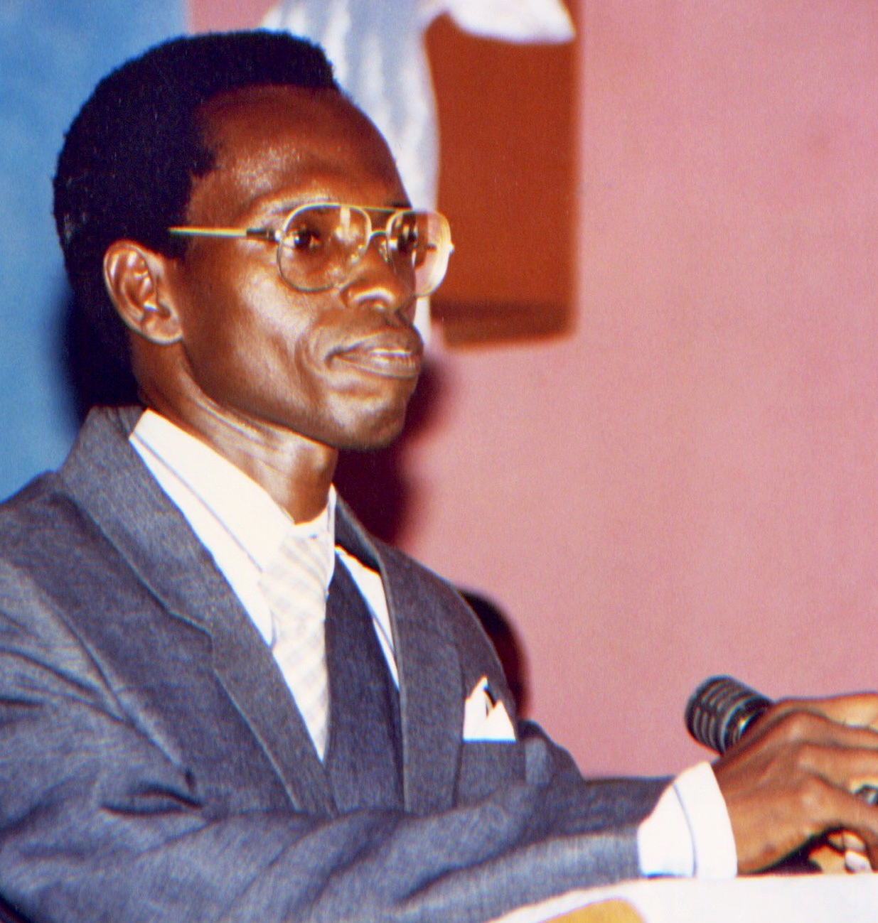
3) The Teacher
Must have completed seminary, Bible College, BTCP or have similar skills and knowledge
Is a guide and active disciple
Must substantially agree with the BTCP doctrinal statement
Able to teach in a cross-denominational, relational setting

Slide 16

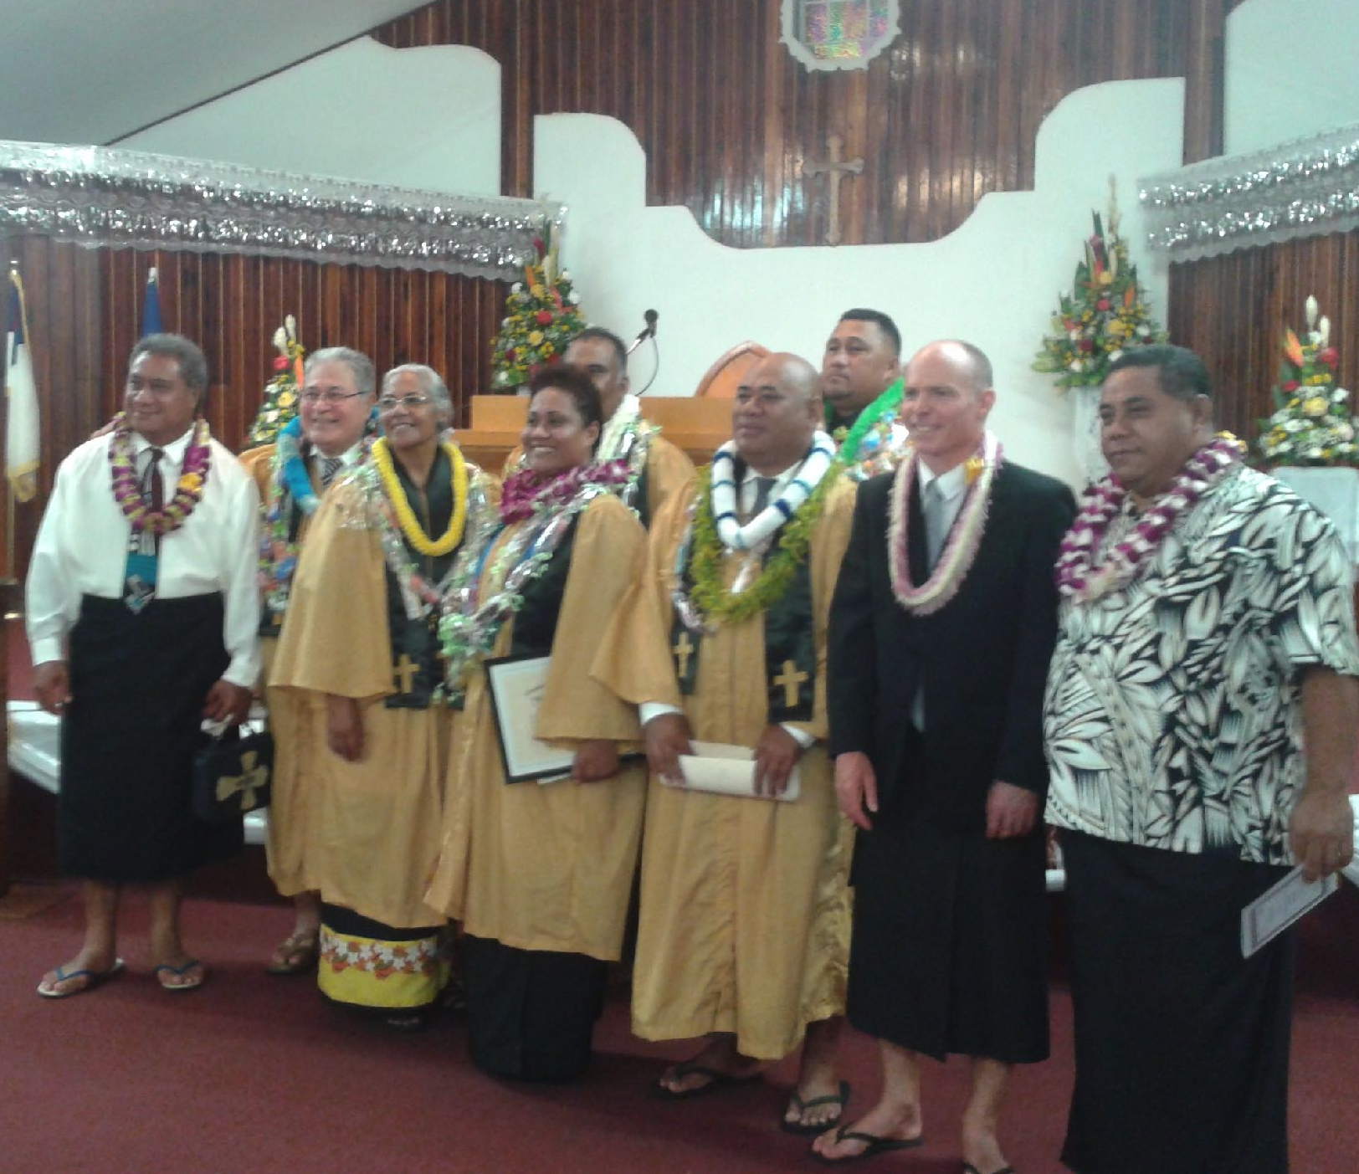
BTCP’s Training Method
Non-formal training (no tests, grades, degrees or diplomas)
Face to face, relational training (distance training is not permitted)
Provides the “irreducible minimum”
Enables students to train others
No academic credentials needed, but literacy is necessary
Cross-denominational setting

Slide 17

What questions do you have about BTCP’s training method?

Slide 18
3 Tiers of Training
Across 10 Courses

Slide 19

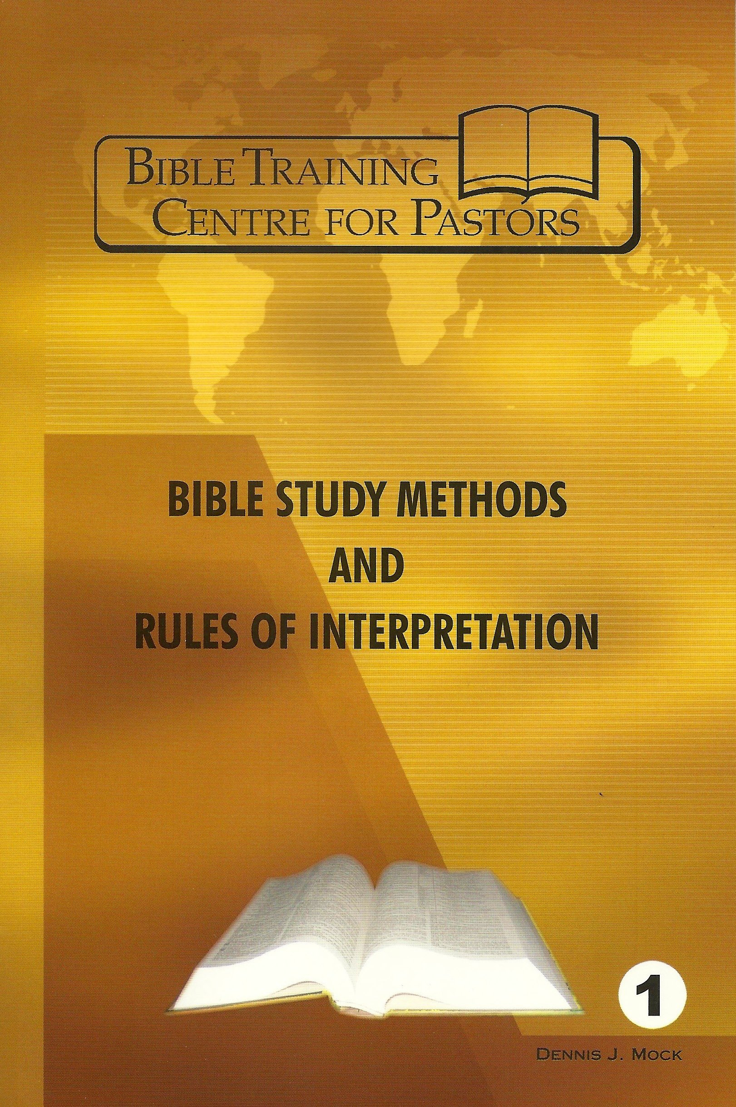
BTCI • 5 Core Courses • 275 Hours
Personal & Corporate Spiritual Life
55 Hours
Bible Doctrine Survey
60 Hours
New Testament Survey
60 Hours
Old Testament Survey
60 Hours
Bible Study Methods & Rules of Interpretation
40 Hours

Slide 20


BTCL • 8 Courses • 400 Hours
Missions Evangelism Discipleship
60 Hours
Church Ministry Administration & Education
40 Hours
Personal Spiritual Life
40 Hours
Bible Doctrine Survey
60 Hours
Communicating Biblical Messages
40 Hours
New Testament Survey
60 Hours
Old Testament Survey
60 Hours
Bible Study Methods & Rules of Interpretation
40 Hours

Slide 21



BTCP • 10 Courses • 520 Hours
Missions Evangelism Discipleship
60 Hours
Church History Survey
60 Hours
Teaching Principles & Methods
40 Hours
Church Ministry Administration & Education
40 Hours
Personal Spiritual Life
40 Hours
Bible Doctrine Survey
60 Hours
Preaching Biblical Messages & Pastoral Ministry
60 Hours
New Testament Survey
60 Hours
Old Testament Survey
60 Hours
Bible Study Methods & Rules of Interpretation
40 Hours

Slide 22

Questions & Answers

Slide 23
Preliminary Guidelines

Slide 24
Your Cost for Operation
Forming and maintaining a partnership = $0
2-day partner orientation workshop = $75
North American course fees = $20 per student, per course
International course fees = $11 per student per course
Shipping and handling = $0
* Partners cover import fees, duty, taxes, etc.

Slide 25
Why BTCP Requires In-Person Training
The biblical pattern is personal and relational
Teachers share more than just information; they model the life and ministry they are teaching
Students learn from one another through fellowship, discussion, and shared ministry experiences
Future leaders are identified and developed through classroom interaction

Slide 26
BTCP & Pastor Qualifications
BTCP does not ordain anyone
We are convicted by Scripture that a pastor fulfills the office of elder and should be held by a man who meets the requirements outlined in 1 Tim 3 and Titus 1
The BTCP program should not be used as a pathway for or women or divorced individuals to serve in the office of pastor or elder
BTCI or BTCL programs are excellent programs that can be used to train any disciple who wishes to be trained
Pastor qualification position papers will be provided in a follow-up email

Slide 27
Please Fill Out the Attendance Poll

Slide 28

Did We Meet Our Objectives?
Did we share BTCP’s mission, purpose, and approach?
Do you better understand how BTCP conducts pastor training?
Do you better understand whether BTCP partnership is right for you?

